Slide 1
Project Title:Predictive Modelling for Heart Disease Risk Assessment Using Logistic Regression in Machine Learning
CAPSTONE PROJECT | REVIEW 1 | REQUIREMENTS, LITERATURE SURVEY AND PROPOSED DESIGN
Team ID: G11 Batch: 2023–2027 Semester: 7 / 8 Project Guide: Dr. B. Perumal
Department of Electronics and Communication Engineering
Kalasalingam Academy of Research and Education | Date of Review: [14 october,2026]

Slide 2
Team Formation and Roles
Every member should be able to explain the whole project, not only their own module.
S.No | Name | Register No. | Relevant Skills / Prior Work | Role and Subsystem
1 | S. Yashika | 9923005281 | C Programming,Python,Ardiuno IDE,ESP32 ,Proteus ,MATLAB (Basic) | User Interface & Visualization Unit (Streamlit Web Framework and Plotly real-time charts)
2 | S. Abarna | 9923005233 | C Programming,Python,Ardiuno IDE, ESP32,Proteus,MATLAB(Basic) | Processing & ML Intelligence Unit (Python, Scikit-Learn, Logistic Regression model and StandardScaler)
3 | Animala GuruSaiNath | 9923005003 | C programming,Ardiuno IDE, Proteus, MATLAB(Basic) | Sensor & Edge Acquisition Unit (ESP32, MAX30102, AD8232 hardware wiring and serial telemetry)
Project Guide: Dr. B. Perumal Title approval by Reviewer Committee: Approved Team repository: [https://github.com/ece-kalasalingam/capstone-odd-team-G11] Created: Yes

Slide 3
PI1 · CO1 · 20 marks
Team-level (with next slide)
Need Analysis: Field Evidence
Summarises Step 2 §1–2. Looks for: 2+ evidence types, quantified findings, proof attached.
Evidence Type | Source / Respondents | Date | Key Finding (with numbers) | Proof (Appendix #)
Survey, 10+ respondents | public & university peers (13 respondents) | 10.9.2026 | 76.9% lack real-time risk screening tools | Appendix 1
government report | Ministry of Health and Family Welfare (MoHFW) Report | 15.9.2026 | CVDs cause >28% deaths due to late diagnosis | Appendix 2
Where and how we noticed the problem: The problem was identified through an online survey conducted among the public and university students, along with findings from the Ministry of Health and Family Welfare (MoHFW) report.
Who is affected, and roughly how many: People at risk of cardiovascular diseases are affected by delayed detection and lack of regular health monitoring. Our survey highlights the need for accessible screening tools.
Evidence note: The survey involved 13 respondents, of which 76.9% indicated the need for real-time risk screening tools. This was supported by the MoHFW report on cardiovascular disease-related deaths in India.

Slide 4
Root Cause, Impact and Problem Statement
PI1 · CO1 · 20 marks
Team-level (with previous slide)
Summarises Step 2 §3–6. Looks for: a true root cause and a solution-free statement.
[28%]
CVD share of total deaths in India due to delayed detection (MoHFW Report)
ROOT CAUSE → FINAL PROBLEM
WHY 1 — Symptom: Delayed detection of cardiovascular risk during early non-emergency stages.
WHY 2 — Cause: Lack of continuous, real-time physiological health monitoring tools at home/clinics.
WHY 3 — Root cause: High cost and physical accessibility barriers of institutional diagnostic equipment.
FINAL PROBLEM STATEMENT
At-risk individuals face unmonitored cardiovascular anomalies, causing delayed diagnosis and high mortality. A successful solution must offer affordable, real-time risk screening.
[76.9%]
Survey Respondents Willing to Use the Proposed Heart Disease Risk Assessment System (Survey Data)
Finalised title: Predictive Modelling for Heart Disease Risk Assessment Using Logistic Regression in Machine Learning

Slide 5
PI2 · CO1 · 15 marks
Team-level (3 slides)
Literature Reviewed
Summarises Step 3 §1. Looks for: 6+ papers in your own words, with specific limitations.
Paper (IEEE format) | What It Did / Approach Used | Limitation (for our problem)
[1] N. F. Zulkiflee and M. S. Rusiman, “Heart Disease Prediction Using Logistic Regression,” Enhanced Knowledge in Sciences and Technology, vol. 1, no. 2, pp. 177–184, 2021. | Binary Logistic Regression was applied to 270 patient records for heart disease prediction.. | The study used a relatively small dataset, limiting wider population evaluation.
[2] M. N. Uddin and R. K. Halder, “An Ensemble Method Based Multilayer Dynamic System to Predict Cardiovascular Disease Using Machine Learning Approach,” Informatics in Medicine Unlocked, vol. 24, Art. no. 100584, 2021. | An ensemble model combining Random Forest, Naïve Bayes, and Gradient Boosting was developed.. | The multilayer ensemble approach involves greater implementation complexity than a simple classification model.
[3] X. Qian, Y. Li, X. Zhang, H. Guo, J. He, X. Wang, Y. Yan, J. Ma, R. Ma, and S. Guo, “A Cardiovascular Disease Prediction Model Based on Routine Physical Examination Indicators Using Machine Learning Methods: A Cohort Study,” Frontiers in Cardiovascular Medicine, vol. 9, Art. no. 854287, 2022. | Machine learning algorithms were used to predict cardiovascular disease using routine physical examination indicators. | The model was developed for a specific population and requires validation in other populations.

Slide 6
Paper (IEEE format) | What It Did / Approach Used | Limitation (for our problem)
[4] S. Srinivasan, S. Gunasekaran, S. K. Mathivanan, B. A. M. M. B., P. Jayagopal, and G. T. Dalu, “An Active Learning Machine Technique Based Prediction of Cardiovascular Heart Disease from UCI-Repository Database,” Scientific Reports, vol. 13, Art. no. 13588, 2023. | An active learning-based machine learning technique was applied to cardiovascular disease prediction using the UCI database. | The study focuses on an active learning approach, requiring further evaluation across different datasets.
[5] M. T. García-Ordás, M. Bayón-Gutiérrez, C. Benavides, J. Aveleira-Mata, and J. A. Benítez-Andrades, “Heart Disease Risk Prediction Using Deep Learning Techniques with Feature Augmentation,” Multimedia Tools and Applications, vol. 82, pp. 31759–31773, 2023. | Deep learning techniques with feature augmentation were used for heart disease risk prediction. | Deep learning methods require more computational resources than lightweight models.
[6] H. A. Al-Alshaikh, P. P., R. C. Poonia, A. K. J. Saudagar, M. Yadav, H. S. AlSagri, and A. A. AlSanad, “Comprehensive Evaluation and Performance Analysis of Machine Learning in Heart Disease Prediction,” Scientific Reports, vol. 14, Art. no. 7819, 2024,. | Multiple machine learning classification algorithms were evaluated for heart disease prediction. | Further real-world validation and evaluation across a wider range of cardiovascular conditions are needed.
Pattern across the papers: Existing works lack low-cost IoT physical sensors combined with real-time Logistic Regression web screening.

Slide 7
Existing Products, Patents and Repositories
PI2 · CO1 · 15 marks
Team-level (3 slides)
Summarises Step 3 §2–3. Looks for: 2+ real products, 1+ patent or repo, limitations stated.
Products / Systems
Product / System | Made By | What It Does | Limitation
OMRON Complete BP Monitor + ECG | OMRON Healthcare | Combines BP & ECG tracking | No Logistic Regression or custom IoT
Philips Wearable Biosensor Technology | Philips | Monitors HR, respiration & vitals | Lacks clinical parameter ML prediction
Patents (or open-source repositories for software projects)
Patent Title and Number / Repo Link | What It Covers | How Our Project Differs
Medical Diagnostic Tool for Predicting Coronary Disease from ECG Signals (US12040093B2) | Predicts heart disease using ECG and neural networks. | Uses Logistic Regression with 13 clinical parameters and planned IoT monitoring.
Fingertip Part Physiological Characterization Detection Device (CN215937341U) | Measures heart rate and SpO₂ using sensors. | Combines pulse, SpO₂ and ECG monitoring with Logistic Regression-based risk prediction.
Patents were searched using Google Patents with keywords related to ECG-based heart disease prediction and physiological monitoring.

Slide 8
PI2 · CO1 · 15 marks
Team-level (3 slides)
Gap Analysis and Justification
Summarises Step 3 §4–5. Looks for: a gap that follows from the limitations just shown.
What Our Solution Needs to Do | Covered by Existing Work? | Which Refs / Products
Predict heart disease risk using clinical parameters | Yes | Research Papers [1], [3], [4], [6]
Provide a simple, understandable prediction interface | Partly | Research Papers [2], [5]; Streamlit-based proposed interface
Combine machine learning with IoT-based physiological monitoring | Partly | OMRON BP Monitor + ECG Philips Wearable Biosensor
Present preliminary results while encouraging professional medical assessment | Partly | Research Papers [1]–[6]
Justification for the project: Existing research uses machine learning to predict heart disease risk, while commercial devices monitor physiological parameters. Our project integrates Logistic Regression, ESP32-based sensors (MAX30102 and AD8232), and a Streamlit interface for preliminary risk assessment. The system supports early screening but does not replace professional medical diagnosis.

Slide 9
Functional and Performance Requirements
PI3 · CO1 · 15 marks
Team-level
Summarises Step 4 §1–2. Looks for: measurable, testable, traceable. Targets are baselined now.
Functional (5–8 in Step 4) Performance (3–5 in Step 4)
ID | The System Must Be Able To... | Need (Step 2)
FR1 | Accepts 13 clinical input attributes for heart disease risk prediction. | N1
FR2 | Predicts heart disease risk using the trained Logistic Regression model | N1
FR3 | Displays risk probability and risk category in the Streamlit interface. | N2,N4
FR4 | Collects heart rate,SpO2,and ECG signals using ESP32-connected sensors | N3
FR5 | Shows sensor readings and predicted heart disease risk together in Streamlit. | N2,N3,N4
ID | Measured | Target | Verified By | Links (optional)
PR1 | Accuracy | 86.89% baseline | Model evaluation | FR2
PR2 | ROC-AUC | 95.35% baseline | ROC-AUC evaluation | FR2
PR3 | Input attributes | 13 attributes | Input validation | FR1
PR4 | Sensor readings | Heart rate, SpO₂ and ECG | Sensor testing | FR4
Use the exact IDs from Step 4 on every later slide. Vague wording such as "user-friendly" or "works well" scores Level 0. Targets are baselined at
this review; Review 2 tests against them, and any later change must be documented, justified and approved by the guide.

Slide 10
Standards, Constraints and SDGs
PI4 · CO2 · 10 marks
Team-level
Summarises Step 4 §3–6. Looks for: cited standards, every category addressed, SDG link specific.
Standards / Codes
IEEE 802.11: ESP32 Wi-Fi
communication.
ISO/IEC 25010:2023: Software quality evaluation.
Constraint Type | Details, or Why Not Applicable
Economic | Total estimated project budget: ₹2,263.
Environmental / Sustainability | Uses 3.3V operating logic and low-power ESP32-based sensor components..
Manufacturability / Feasibility | Uses 1 ESP32, 1 MAX30102, 1 AD8232 for prototype development.
Ethical / Health and Safety | Measures 3 physiological parameters: Heart Rate, SpO₂ and ECG. Provides screening support, not medical diagnosis.
Social | Accepts 13 clinical attributes and displays risk results through one Streamlit interface.
Regulatory / Legal / Political | Follow applicable medical-device and patient-data privacy requirements.
Data ethics and management | Collects 13 clinical input attributes; patient information must be handled confidentially.
SDGs (1–3)
SDG 3 Good Health and Well-being: Supports early heart disease risk screening
Target :Improve early risk awareness

Slide 11
Objectives and Scope
Objectives (specific and measurable)
O1:To develop a Logistic Regression model using 13 clinical attributes to predict the risk of heart disease accurately.
O2:To design and develop a user-friendly web application using Streamlit to display heart disease risk predictions and their corresponding probability.
O3:To develop an IoT-based monitoring system for measuring Heart Rate, SpO₂ and ECG signals and displaying the readings through the web application.
Scope
1.Predict heart disease risk using Logistic Regression.
2.Monitor heart rate and SpO₂ using MAX30102.
3.Capture ECG signals using AD8232.
4.Integrate sensor data with ESP32 and a web dashboard.
5.Support early risk screening and remote monitoring.

Slide 12
Candidate Design Approaches
PI5 · CO2 · 15 marks
Team-level (1 slide)
Summarises Step 5 §1. Looks for: 2–3 approaches that differ in core method, not components.
Approach | Core Method and Brief Description | Key Advantage | Key Drawback
A | Logistic Regression using clinical data | Simple and fast | Manual inputs required
B | Machine Learning with IoT sensors | Combines prediction and monitoring | Sensor integration needed
C | Deep Learning for heart disease prediction | Learns complex patterns | Requires more data and computing
Check: The three approaches use different methods: clinical data-based Logistic Regression, Machine Learning with IoT sensors, and Deep Learning. All three approaches were considered, and Approach B was selected based on its overall evaluation.

Slide 13
PI5 · CO2 · 15 marks
Team-level (1 slide)
Comparison and Final Selection
Summarises Step 5 §2–4. Looks for: criteria from your requirements, evidence-based choice.
Criterion (3–5) | Weight | A: Score + Note | B: Score + Note | C: Score + Note
Accuracy potential | 0.30 | 3 - Baseline | 4-Combined system | 4 – Complex patterns
Cost | 0.25 | 4 – Low cost | 3 – Sensor cost | 2 – Higher resources
Ease of implementation | 0.25 | 4 - Simple | 3 – Integration needed | 2 – Complex
Physiological monitoring | 0.20 | 1 – Not included | 4 – Sensors included | 1 – Not included
Weighted score | 1.00 | 3.10 | 3.50 | 2.40
Use this weighted table (Option 2 in Step 5), or show the qualitative comparison (Option 1) if that is what you submitted. Weights add to 1.00; scores run 1–4, with 4 best.

Slide 14
Selected approach and why: Approach B – Integrated Software and Hardware System using Machine Learning and IoT, combining Logistic Regression with ESP32-based sensors.
Novelty vs Step 3: Combines clinical data-based risk prediction with real-time Heart Rate, SpO₂ and ECG monitoring through a web application.
IP overlap: Existing prediction and monitoring systems are available, but this project combines both functionalities in one web application.
TRL (1–9): TRL 3 – Experimental Proof of Concept; software evaluation completed, hardware integration and testing planned.

Slide 15
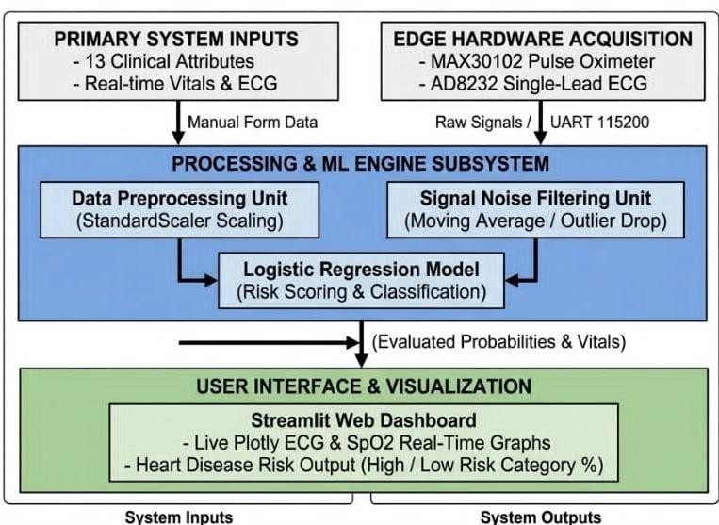
PI6 · CO2 · 10 marks
Team-level (1 slide)
System Architecture and Traceability
Summarises Step 6 §1–2. Looks for: legible diagram, every requirement mapped. Proposed design only.
System inputs: 13 Clinical Attributes, Sensor Vitals (Heart Rate, SpO2, ECG)
System outputs: Heart Disease Risk Probability (%), Real-time Streamlit Dashboard Display
Req. ID | Requirement | Subsystem
FR1 | Accept 13 clinical inputs | S1
FR2 | Predict heart disease risk | S2
FR3 | Risk output | S2
PR1 | 86.89% accuracy | S3
Every functional requirement needs a subsystem; every subsystem here needs a block in the diagram.

Slide 16
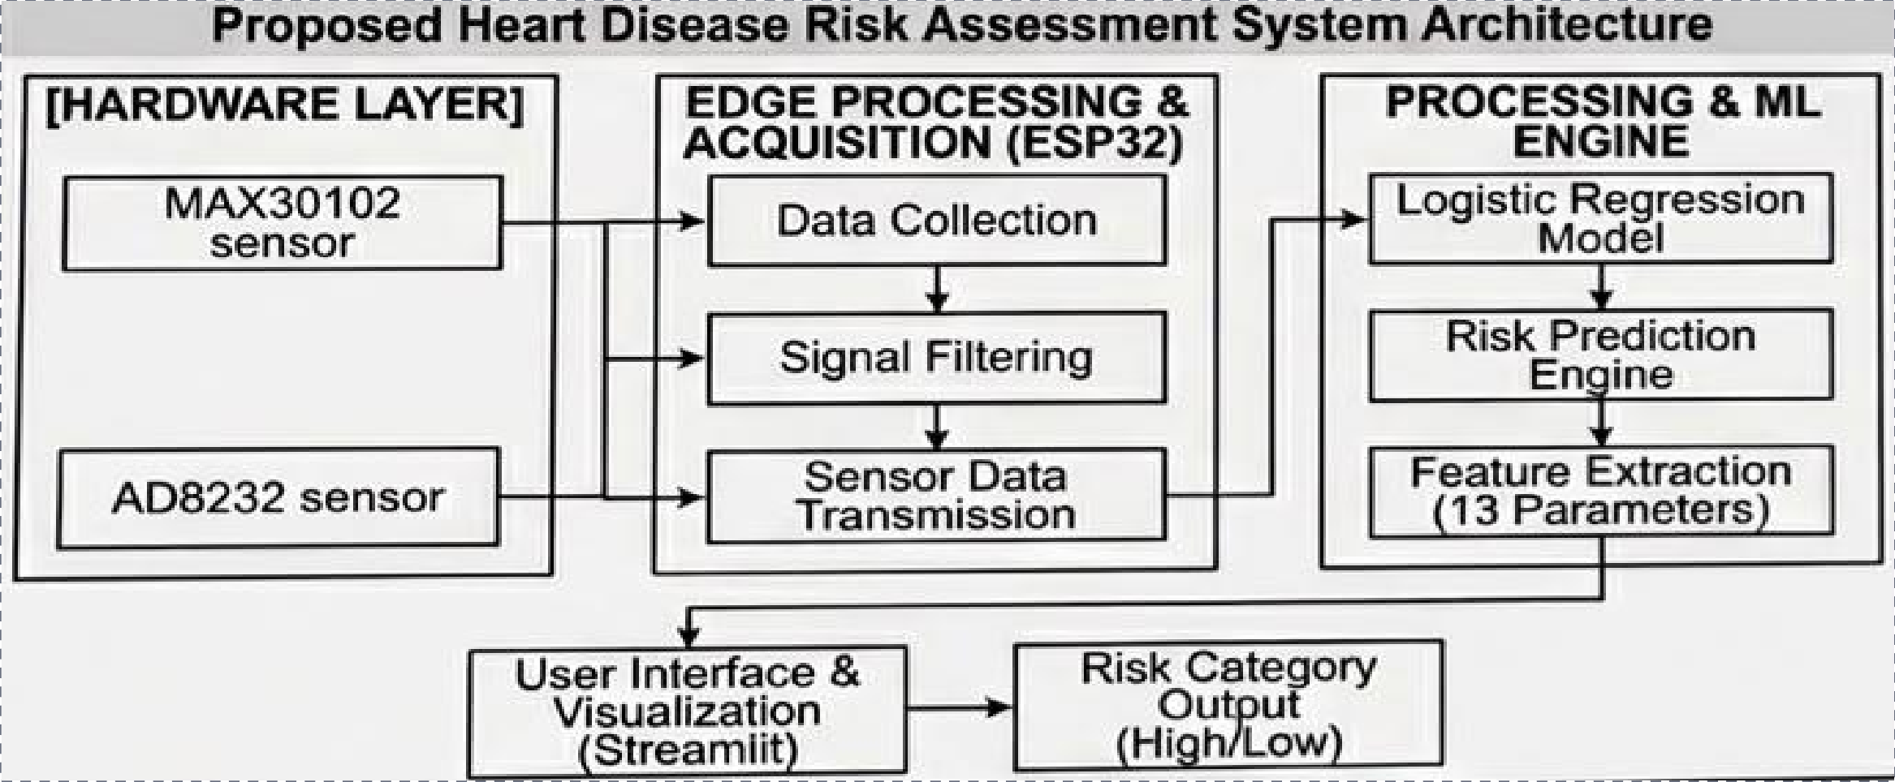
System Architecture and Traceability
PI6 · CO2 · 10 marks
Team-level (1 slide)
Summarises Step 6 §1–2. Looks for: legible diagram, every requirement mapped. Proposed design only.
Every functional requirement needs a subsystem; every subsystem here needs a block in the diagram.

Slide 17
Work Breakdown and Responsibilities
PI7 · CO5 · 15 marks
Individual-level (6 slides)
Summarises Step 1 §1–2. Looks for: a named owner for every subtask. No 'all team members'.
Per-Student View
Student A [9923005233]: subtasks [1.1,1.4,2.1,2.4,3.1,4.2,5.1,6.1];
deliverables [Report, hardware
plan, test results ]
Student B [9923005281]: subtasks [1.2,1.5,2.2,3.3,4.1,4.4,5.3,6.2];
deliverables [Report, hardware plan, test results]
Student C [9923005003.]: deliverables [ Report, hardware plan, test results]
Task | Subtask Owner (Reg. No.)
1.0 Literature Review | 1.1 [9923005281] · 1.2 [9923005233] · 1.3 [9923005003] · 1.4 [9923005281] · 1.5 [9923005233]
2.0 Requirements and Constraints | 2.1 [9923005233] · 2.2 [9923005281] · 2.3 [9923005003] · 2.4 [9923005003]
3.0 Concept Development | 3.1 [9923005281] · 3.2 [9923005233] · 3.3 [9923005003]
4.0 Final Design and Implementation | 4.1 [9923005003] · 4.2 [9923005281] · 4.3 [9923005233] · 4.4 [9923005003]
5.0 Testing and Evaluation | 5.1 [9923005281] · 5.2 [9923005233] · 5.3 [9923005003] · 5.4 [Reg]
6.0 Report and Final Presentation | 6.1 [9923005233] · 6.2 [9923005281] · 6.3 [9923005003]
Every subtask has a named owner. Tasks 4.0 and 5.0 are expected to loop: testing can send the design back for revision (subtask 5.4).

Slide 18
PI7 · CO5 · 15 marks
Individual Contributions
Individual-level (6 slides)
Each member presents their individual contribution to the completed pre-Review 1 activities, supported by verifiable documentary evidence.
Member | Work Done This Period | Evidence (commits, log, report section)
Abarna S | Dataset preprocessing and Logistic Regression model development | Python code, model results
Yashika S | Streamlit interface development and prediction display | UI screenshots, source code
Animala guru sainath | ESP32 sensor integration, testing and report documentation | Hardware photos, report pages

Slide 19
PI7 · CO5 · 15 marks
Individual-level (6 slides)
Timeline
Summarises Step 1 §3. Shift the marked weeks to match your actual duration and pace.
Task | W1 | W2 | W3 | W4 | W5 | W6 | W7 | W8 | W9 | W10 | W11 | W12
1.0 Literature Review | W1 | W2 | W3
2.0 Requirements |  | W2 | W3 | W4
3.0 Concept Development |  |  |  | W4 | W5
4.0 Design / Implementation |  |  |  |  | W5 | W6 | W7 | W8 | W9 | W10
5.0 Testing |  |  |  |  |  |  |  | W8 | W9 | W10 | W11
6.0 Reporting |  |  |  |  |  |  |  |  |  | W10 | W11
Key milestones: [Subsystem prototypes by Wk _; integration by Wk _; testing complete by Wk _. Pale bars are only the Step 1 suggested pattern, not an approved schedule: replace them with your actual plan.]

Slide 20
Budget Estimation
PI7 · CO5 · 15 marks
Individual-level (6 slides)
Summarises Budget Estimation §1–4. Looks for: BoM linked to subsystems, evidence of prices.
Hardware / Components (preliminary BoM)
Total Estimated Cost
Subsystem | Component | Specification / Model | Qty | Unit ₹ | Total ₹
[1] | Development Board | ESP32 | 1 | 450 | 450
[2] | ECG & Heart Rate Sensors | AD8232+MAX30102 | 2 | 1130 | 1130
[3] | OLED Display | OLED Module | 1 | 180 | 180
[4] | Breadboard, PCB, Wires, LEDs & Buzzer | Basic components & USB Cables | 1set | 395 | 395
Cost Head | ₹
Hardware | [ 2155]
Software / online | [ 0]
Other expenses | [108 ]
Total | [₹ 2263]
Key component selection: ESP32 (Wi-Fi/IoT); AD8232 & MAX30102 (ECG/SPO2)
Evidence attached: Datasheets & Receipts
Software and other expenses: Open-source (₹0); Printing (₹108)
Note: Do not invent quotations; university-owned resources are ₹0, not purchases.

Slide 21
PI7 · CO5 · 15 marks
Individual-level (6 slides)
Risk Register
Each member states the risks to their own subtasks. Looks for: specific, credible risks with a mitigation plan.
Risk | L / I | Mitigation
[Sensor Data Noise ] · Owner [9923005281] | M/H | Digital software filtering
[Component Delivery Delay ] · Owner [9923005233] | M/M | Local vendor procurement
[ML Model Overfitting ] · Owner [9923005003] | L/H | Dataset cross-validation
[Wi-Fi Connectivity Lag ] · Owner [9923005281] | M/M | Offline data buffering
Each member shall explain the risks associated with their assigned subtasks, the potential impact on project execution, and the proposed mitigation. Team-level risks are permitted, provided that each risk is specific, justified, and assigned to a responsible member.

Slide 22
Next Review Commitments
PI7 · CO5 · 15 marks
Individual-level (6 slides)
Looks for: measurable commitments with a named owner, due week and verifiable evidence.
Commitments for Review 2
Deliverable | Owner (Reg. No.) | Due | Evidence to Verify
Complete sensor integration | [9923005233] | [Week 6] | Sensor test photos
Test Logistic Regression model | [9923005281] | [Week 5] | Accuracy results
Integrate Streamlit interface | [9923005003] | [Week 7] | Interface screenshots
Test complete system | [9923005233] | [Week 8] | Test results

